Slide 1
PROMEF 3D reconstruction of extremely heterogeneous structures in carbonates using 2D images
PIs: Zeyun Jiang, Rink van Dijke, Sebastian Geiger, Rachel Wood
PhD students: Tianshen Huang, Dmytro Petrovskyy

Slide 2
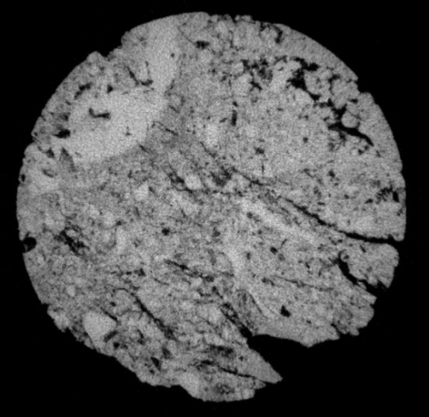
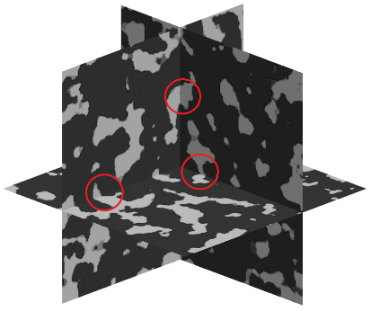
3D Reconstruction using 2D images
Why not (just) 3D CT?
Sub-resolution: trade-off between sample size and resolution
Accurate location of desired sample
When micro-porosity dominates…
Our previous work:
PAR (Pore Architecture Reconstruction)
Relatively poor connectivity in 3rd direction
Only for uniform structure
Notes:
Add SEM graph
Logic of our study: 1.we know the shortcomings of 3DCT, and 3D reconstruction provides an alternative to solve the sub-resolution problem
2.But before directly running simulations using real pre-salt data, we need to develop a robust algorithm that can deal with various types of features. And we start by reconstructing simple structure, then gradually improve the method to deal with more complex structure.
3.Meanwhile we validate our model by various quantification measurement. In return, the error between real data indicates us the drawback of our algorithm that needs to be improved.
4.Finally we apply to the presalt data. So that we tend to believe in our model to the best extent

Slide 3
Outline
Wide variety of complex porous structures reconstructed
Validation in geometry and petro-physical properties
Methodology
Future work
Case study (Cross-scale connection)
Analysis on sponsors’ real data

Slide 4
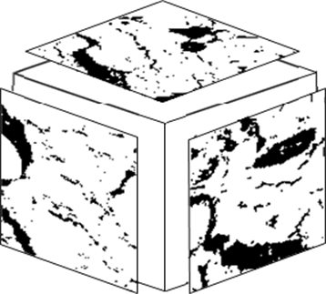
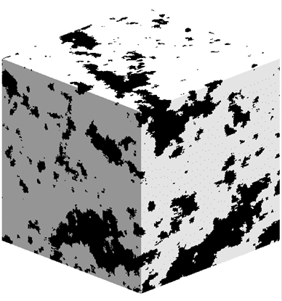
3D Reconstruction using 2D images
Illustration:
X
Y
Z
Input:
2D images in X, Y and Z direction
Output:
3D models
Notes:
in the next few slides, we are presenting a series of 3D reconstruction model using 2D images as input, Just like this illustration shows.
The input are either 3 different images for 3 directions, or the same image for 3 directions.
Two-scale: there are a varied range of pore/solid size, generally large pores and small pores.

Slide 5
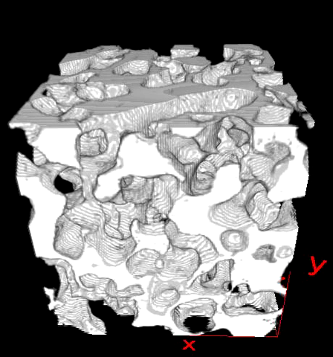
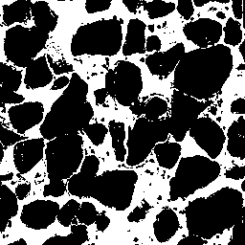
Uniform structures
Grain stone
Notes:
Rounded grains

Slide 6
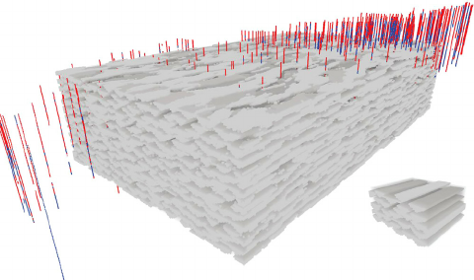
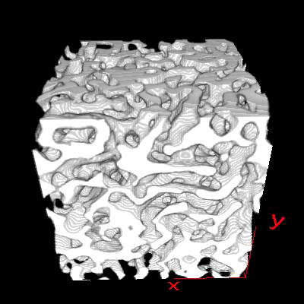
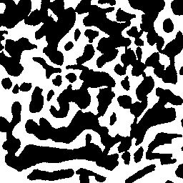
Uniform structures
Stromatolite ‘structure 2’
from the Neoproterozoic of the Irece Basin, Bahia, Brazil
Patrick et al. 2015, The Geological Society of London
A 2D binary image
Gregoire Mariethoz, Sylvain Lefebvre, 2014, Computers & Geosciences
Notes:
Long range connectivity
Dimension-less, or scale-free use Sebastian graph
Anisotropic?
<Microbial carbonates: a sampling and measurement challenge for petro-physics addressed by capturing the bio-architectural components>The Geological Society of London 2015

Slide 7
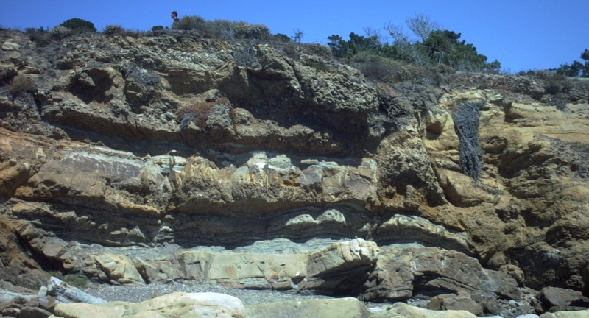
Courtesy Dan Arnold (IPE), image from IPE field trip to Spain
Notes:
Scale free

Slide 8


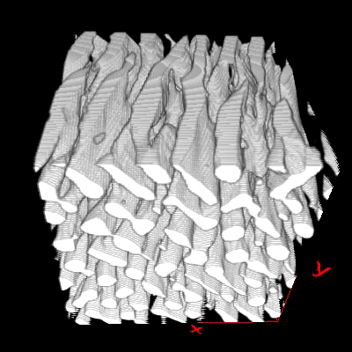
Anisotropic
Simplified stromatolite ‘Zebra line’
X,Y direction
Z direction
Notes:
if appropriate TIs are provided, a natural structure can be reconstructed

Slide 9
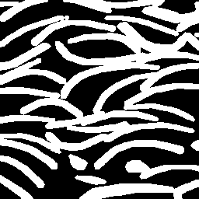
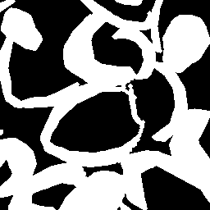
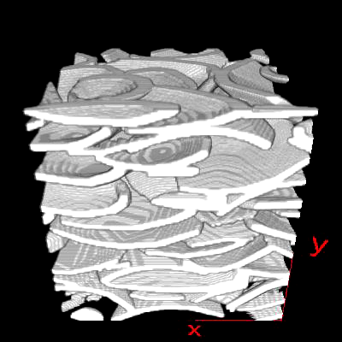
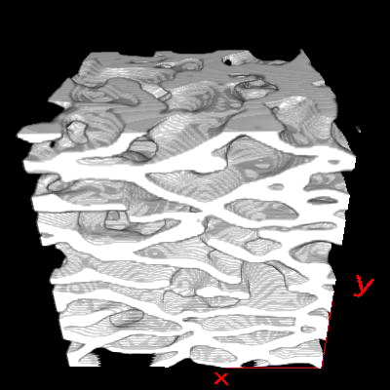
Anisotropic
ROCKTYPE’s Coquina
X,Y direction
Z direction
ROCKTYPE’s model
Reconstruction
Notes:
Non-parametric vs. parametric: more flexibility

Slide 10
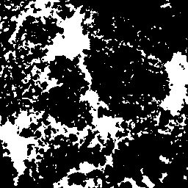
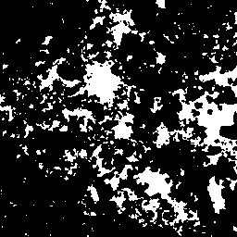

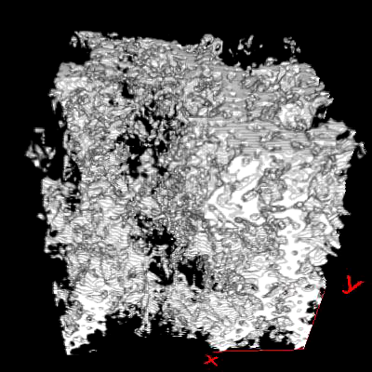
Non-stationary
‘Two-scale C’
Φ(X)=27.0%
Φ(Y)=19.6%
Φ(Z)=4.9%
Notes:
A wider definition of stationary is used in geostatistics, meaning the multiple-point statistics remains stable or stationary in the spatial domain. So the non-stationary means the spatial heterogeneity in terms of porosity, in other words, the size of pore and solid varied strongly, which is different from uniform structure like sandstone.
Non-stationarity : in same slice, different region; in different slice.

Slide 11
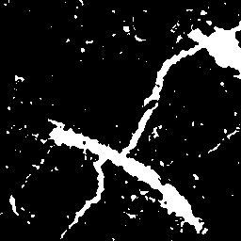
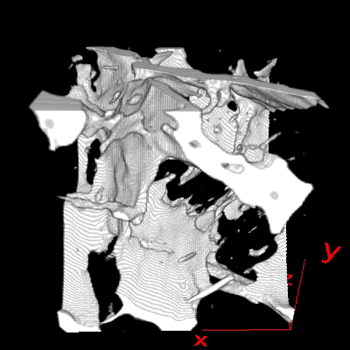
Irregular / extreme shape
Network of fractures
Notes:
Network of fractures. 2 fractures intersecting each other.
Plus some metrix pore in between
Again, need to point out that we just use single TI for three directions.

Slide 12
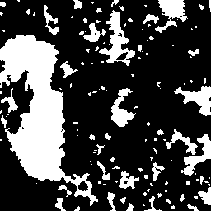
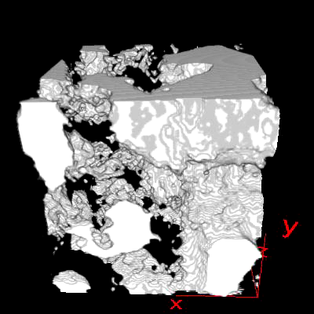
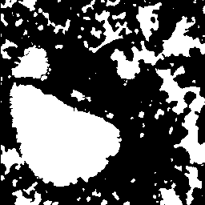
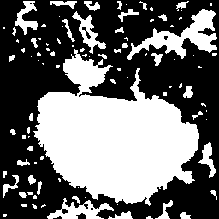
Irregular / extreme shape
‘Two-scale B’
Notes:
Successfully reconstruct both large / small pores, the huge pore in Tis is generated realistically.
The connection in different directions are honoured, especially for larger pores.
Small pores are distributed non-uniformly around the large pores. Although the proportion of small pores tends to be lower than TIs.
These kind of non-stationary and two scale model can hardly be reconstructed by previous non-parametric methods.

Slide 13
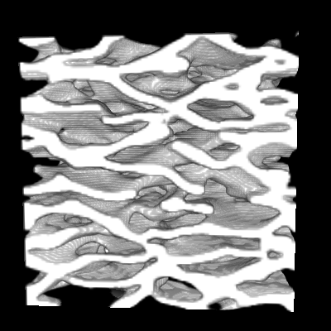
Validation – structural connectivity
ROCKTYPE’s Coquina, Berea
X,Y direction
Z direction

Slide 14
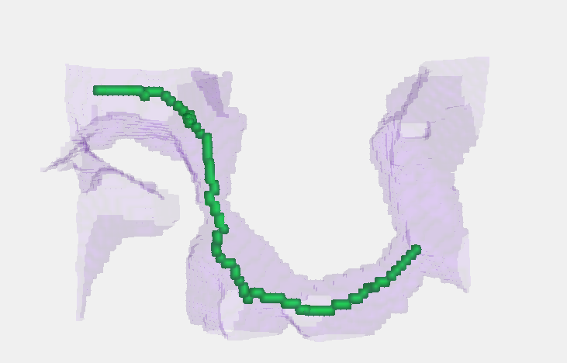

Validation – shape factor
Definition of shape factor
A
G = 0.045
A = 44.30
P = 31.21
G
=
P
2
Extraction of 13 cross sections
Notes:
In order to compare the geometry similarity, we also quantify the shape by the measurement of shape factor.
which is calculated as area divided by square of perimeter.
For a 3D model, we compute the shape factor for all the cross sections extracted from each pore, then we get a distribution of pore shapes for this model, in a way similar to PSD.

Slide 15
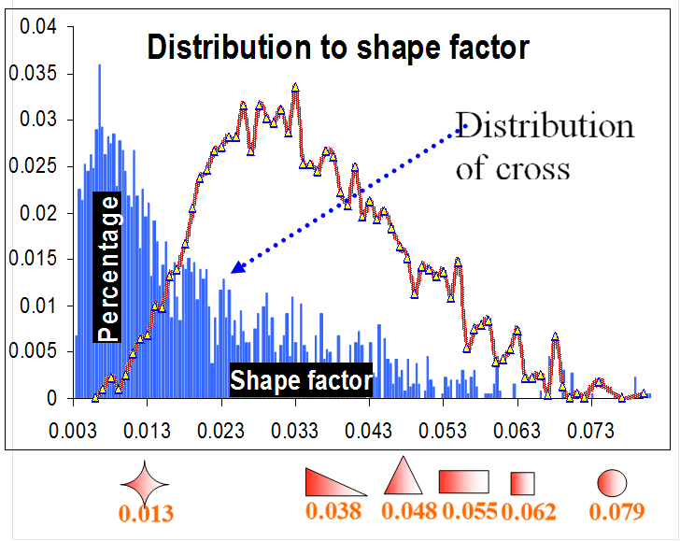
Validation – shape factor
ROCKTYPE’s Coquina
Notes:
Here we get the distribution of shape factor for ROCKTYPE’s coquina model and our reconstructions, as the ones showed previously. With some typical shapes at certain values shown below.
It is clear that the overall distribution is matched very well, while there are some slight difference between each reconstruction, because our method is stochastic reconstruction.

Slide 16
Validation – porosity
Automatically matched global statistics (esp. porosity)
Porosity Model | TIs (%) | Original 3D (%) | Reconstruction (%) | Relative error (%) with TIs
Ola’s Coquina | 46.0 | 42.2 | 44.7, 44.9 | -2.9, -2.3
‘Structure 2’ | 44.8 |  | 42.4 | -5.2
Grains | 35.4 |  | 33.0, 37.2, 35.3 | -5.0, +6.7, +0.1
‘Two-scale B’ | 35.4 |  | 34.4 | -2.8
Berea | 20.7 | 19.6 | 20.6, 20.0 | -0.4, -3.1
‘Two-scale A’ | 19.8 | 20.5 | 20.3, 20.4 | +2.6, +2.8
‘Two-scale C’ | 17.2 |  | 16.7 | -2.6
Fractures | 10.9 |  | 9.9, 11.8 | -9.8, +8.2

Slide 17
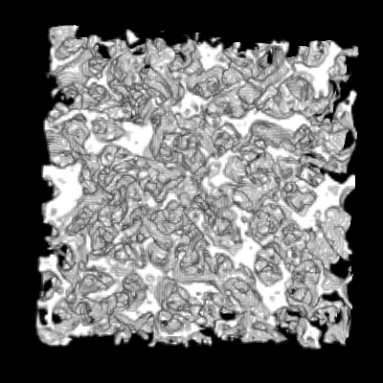
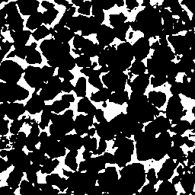
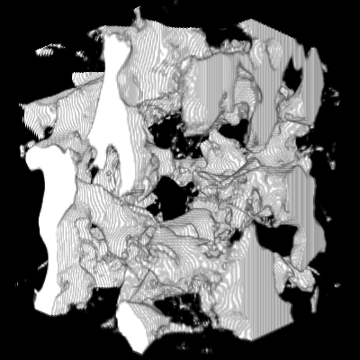
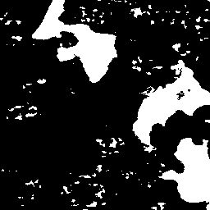
Validation – pore size distribution
Berea
‘Two-scale A’

Slide 18
Validation – flow properties
Network properties | Berea CT | Model
Number of pores: | 6248 | 6164
Number of throats: | 11017 | 10709
Avg. coordination number: | 3.46143 | 3.41775
Net porosity: | 0.19488 | 0.206434
Absolute permeability (mD) | 1594.08 | 2574.78

Slide 19
Methodology overview
Initial model
EM based optimization engine
Distance Map
Histogram control
Bimodal transformation
e.g. PAR
Enable us to distinguish non-stationarity, e.g. the varied pore and solid sizes
Preserve both local similarity & global statistics

Slide 20
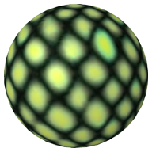
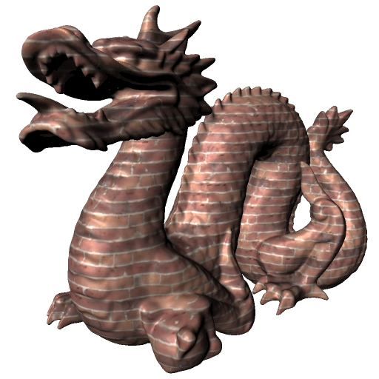
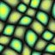

EM based texture synthesis
Expectation Maximization (Arthur et al. 1977)
Estimate parameter and hidden variables iteratively
Extension to texture synthesis:
2D to 2D (Kwatra et al. 2005)
2D to 3D (Kopf et al. 2007)
Kopf et al. 2007 SIGGRAPH
Notes:
From computer science
an expectation–maximization (EM) algorithm is an iterative method to find maximum likelihood estimates of parameters in models, where the model depends on hidden variables.

Slide 21
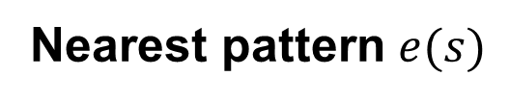
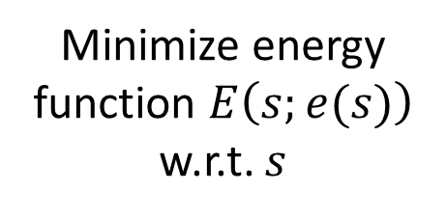

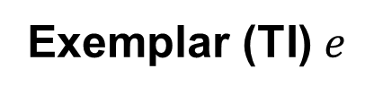
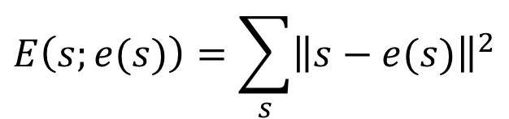
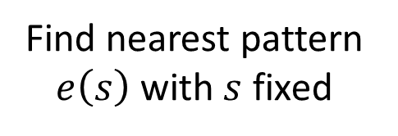
EM based optimization engine
Initial model
EM based optimization engine
Distance Map
Histogram control
Bimodal transformation
e.g. PAR
Exemplar (TI) $e$
Nearest pattern $e(s)$
Model $s$
$$E\left(s;e(s)\right)=\sum_{s}{{\left\|s−e(s)\right\|}^{2}}$$
E-step Optimize
M-step
Search
Minimize energy function $E\left(s;e(s)\right)$ w.r.t. $s$
Find nearest pattern $e\left(s\right)$ with $s$ fixed
Notes:
an expectation–maximization (EM) algorithm is an iterative method to find maximum likelihood estimates of parameters in models, where the model depends on hidden variables.

Slide 22

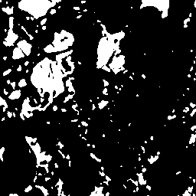
EM based texture synthesis
Limitations:
Simple, uniform: repetitive stationary pattern
Balanced volume fraction: e.g. Φ≈50%
In terms of porous media reconstruction…
Unable for normal porosity structure (e.g. Φ≈20%)
Unable for non-stationary, complex shape

Slide 23
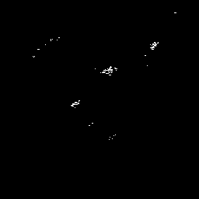
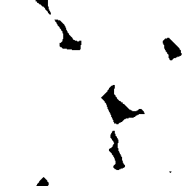
Methodology overview
Initial model
EM based optimization engine
Distance Map
Histogram control
Bimodal transformation
e.g. PAR
Wrong local minimum -- trapped in “large pore / solid”
Notes:
Large in terms of voxels. E.g. the large pore has a radius of 100 voxels while small pores only have 5 voxels.
Simply increasing template size to avoid the trapping is not applicable: 1st the computation and memory cost will increase drastically
2nd big template will tend to lose the details in smaller structure while only capturing the large structures.

Slide 24
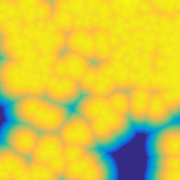
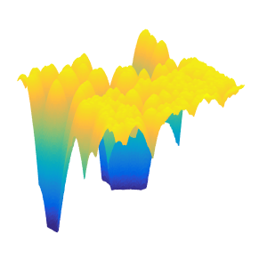
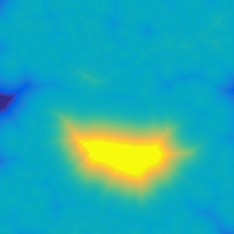
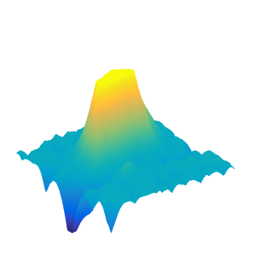
Methodology overview
Initial model
EM based optimization engine
Distance Map
Histogram control
Bimodal transformation
e.g. PAR
Avoid wrong local minimum → distinguish inner area of large pore / solid
Notes:
Distance Map transformation: the color indicates the distance to the nearest boundary of pore and solid.
Plus: you can find some more details of our methodology in the extra slides at the end of my presentation.

Slide 25
Future work
Two-scale features especially smaller scale
Case study: influence of cross-scale connection
Multiple TIs / oblique sections for better quality
Layered structure
Real data analysis

Slide 26
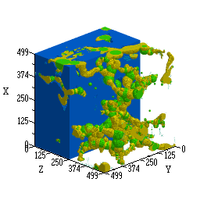
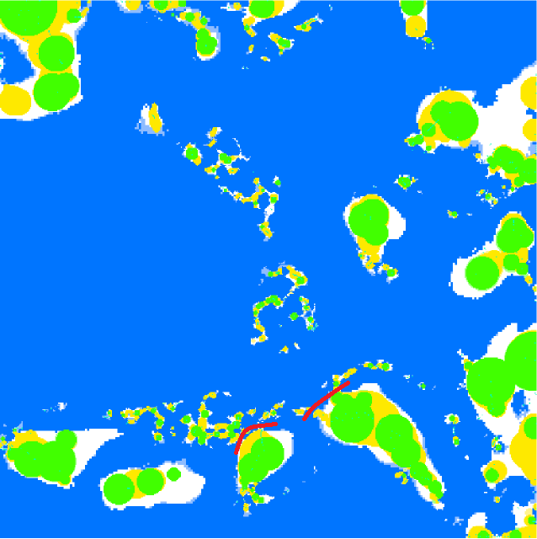
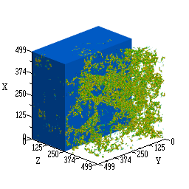
Case study: cross-scale connection
‘Two-scale A’
Macro pores
φ: 0.168
K (mD): 15.63
Cross-scale connection?
with cross-scale connection
φ : 0.203
K (mD): 71.59
Micro pores
φ : 0.036
K (mD): 0.0188
without cross-scale connection
φ : 0.202
K (mD): 18.26
Notes:
The PSD: realistic length
We generate two model, based on different rules of superimposing the micro model and macro model
For the one without cross-scale connection, the flow will go through separately in two sub-network system.
And we compare these two models, to emphasize the influence of cross-scale connection to the flow properties of whole model. This also shows the importance of accurate characterization of finner scale structure.

Slide 27
Case study: cross-scale connection
‘Two-scale A’
without
K = 18.26 mD
+
with
K = 71.59 mD
Notes:
With cross-scale connection, Kro will keep at high level until a much higher water saturation is reached as oil replaces water gradually

Slide 28
Case study: cross-scale connection
Back to reconstruction…
Pore size distribution
Flow properties?
Alternatively, ROCKTYPE(macro) + PROMEF(micro)

Slide 29
Conclusion
An effective method based on optimization framework, for the challenging task of reconstructing complex 3D porous structure using 2D images:
Complex irregular shapes
Anisotropic
Non-stationary, extremely heterogeneous
The wide applicability and quality outperforms previous non-parametric methods
Multi-scale structure will be further improved
Notes:
Partially solved the sub-resolution problem:
We are able to reconstruct both large pores and small pores which are distributed non-uniformly, while the finner scale structure, esp. the tiny pores around large pores are not sufficiently generated, which will be further studied.

Slide 30
PROMEF 3D reconstruction of extremely heterogeneous structures in carbonates using 2D images
Contact:
Zeyun Jiang zeyun.jiang@hw.ac.uk
Tianshen Huang th2@hw.ac.uk
Notes:
LIST PROJECT NAME (EG REACTCARB) AND THE LONGER DESCRIPTION OF THE PROJECT (EG PORE-SCALE REACTIVE TRANSPORT MODELLING) LIST ALL PROJECT PEOPLE BUT UNDERLINE AND BOLD FACE THE KEY PERSON WHO IS DOING THE WORK AND SHOULD BE CONTACTED FIRST (EG ZEYUN)
REMEMBER TO EDIT THE FOOTER OF THE PRESENTATION TO LIST YOUR PROJECT NAME

Slide 31
Impact and integration
Objectives:
Integrate macro-scale model with micro-structure reconstruction honouring realistic cross-scale connection for specific carbonates.
Reconstruct multi-component (oil, water, solid etc.) pore structure based on multi-phase image segmentation.
Provide software tools to measure geometry and topology of experimental samples and carry out pore network simulations, and upscaling multi-phase flow functions with experimental results
ROCKTYPE 2
SATUTRACK 2
GeoMeChem
Main business impact:
Accurate characterization of multi-scale porous media at pore scale
Provide a workflow to complement SCAL for reservoir characterization with proposed upscaling methods.
Technology transfer:
Provide software PAR for investigating complicated microstructure for carbonate rocks in terms of morphological features that directly relates to petro-physics.

Slide 32
PROMEF Team
LEAD PROFESSOR Zeyun Jiang
OTHER PROFESSORS Rink van Dijke
Sebastian Geiger
Rachel Wood
RESEARCHERS Tianshen Huang
Dmytro Petrovskyy
BG FOCAL POINTS PETROBRAS FOCAL POINTS
Rodrigo Surmas
Maury Duarte

Slide 33
PROMEF: Key Facts
Objectives
Accurate pore space reconstruction of multiscale and varying shape structure in Carbonates.
Efficient prediction of multi-phase flow functions at core to log scales
Key deliverables
New workflow incorporating spatial wettability into 3D heterogeneous structures. (Year 2) Task 2, 3
New method for explicit integration of various scale pore space systems. (Year 2) Task 2
Multiphase flow simulations from micro- to meso-scale in heterogeneous carbonates with spatially varying wettability. (Year 3) task 4
Rigorous physically informed flow functions at the meter scale that include structural and wettability heterogeneities at the underlying length-scales. (Year 3) task 5, 6, 7
Business impact
Efficient prediction of multi-phase flow functions based on multi-scale pore space images
Rapid interpretation of log data
Technology transfer
Digital core analysis workflow and software for pore-scale multi-phase flow simulation
Links to Brazil
UFSC, UFPR, Rio Claro (core data, microCT images, pore networks) – SWB visits planned
Publications and presentations
Forthcoming

Slide 34
ICCR Phase II project landscape
Data
VSP
Stevensite
SATUTRACK 2
4D
ROCKTYPE 2
GeoMeChem
MECHSEIS 2
PROMEF
Models
ReactCarb
Workflows developed and tested on shared datasets
Pore-scale
Reservoir-scale
Notes:
THIS SLIDE IS NOW AT THE END OF THE PRESENTATION TO PROVIDE KEY INFORMATION TO THE SPONSORS

Slide 35
PROMEF: Links to other projects
RockType II
Interact on reconstruction of realistic pore structures related to diagenetic events
Provide software tools for multi-phase flow predictions from multi-scale pore space images
SatuTrack II
Obtain pore-scale wettability distributions from experimental data on analogue materials, as well as (trapped) saturation data from micro-CT
Provide software tools for multi-phase flow predictions from multi-scale pore space images
ReactCarb
Obtain semi-quantitative rules that guide distribution of wettability alteration during oil charge
Provide pore-network software tools for multi-phase flow predictions of kr and Pc under different wettability conditions

Slide 36
PROMEF: Deliverables timetable
2015 2016 2017 2018
 | Q1 | Q2 | Q3 | Q4 | Q1 | Q2 | Q3 | Q4 | Q1 | Q2 | Q3 | Q4 | Q1 | Q2
1
2
3
4
5
6
7
8
Key tasks / deliverables
Hiring and training of PhD students, literature review of pore-scale reconstruction, network extraction and multi-phase flow
Pore-space reconstruction 1 – accurately honour pore geometry and topology form 2D to 3D models
Pore-space reconstruction 2 – explicitly integrate multi-scale pore space systems
Parallelise multi-scale network generation – improve cross-scale connectivity (including coarse-links) and spatial correlation
Improve skeleton-based simulation of drainage and imbibition and incorporate spatial wettability into 3D heterogeneous structures
Simulate multi-phase hydraulic and electrical properties from micro- to meso-scale with virtual integrated network
Derive rigorous physically informed flow functions at core- and log-scale
Identify length-scales of representative measurements based on available data

Slide 37
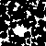





Multi-resolution
TI
Level 0
Level 1
Level 2
Model

Slide 38




Multi-resolution energy minimization
Notes:
an expectation–maximization (EM) algorithm is an iterative method to find maximum likelihood estimates of parameters in models, where the model depends on hidden variables.

Slide 39
Methodology overview
Initial model
EM based optimization engine
Distance Map
Histogram control
Bimodal transformation
e.g. PAR
Wrong local minimum -- trapped in large pore / solid

Slide 40
Methodology overview
Initial model
EM based optimization engine
Distance Map
Histogram control
Bimodal transformation
e.g. PAR
Avoid wrong local minimum → distinguish inner area of large pore / solid

Slide 41


Bimodal transform
Initial model
EM based optimization engine
Distance Map
Histogram control
Bimodal transformation
e.g. PAR
Histogram equalization: enhance low-frequency element
https://en.wikipedia.org/wiki/Histogram_equalization
https://www.math.uci.edu/icamp/courses/math77c/demos/hist_eq.pdf

Slide 42



Methodology overview
Initial model
EM based optimization engine
Distance Map
Histogram control
Bimodal transformation
e.g. PAR
Enhance low-frequency element by ‘clustering’ a range of distance bins.
Notes:
Skip this slide. Too technical

Slide 43






Methodology overview
Initial model
EM based optimization engine
Distance Map
Histogram control
Bimodal transformation
e.g. PAR
Avoid aggregation in single peak model
Equalized Bimodal
distribution
Balanced model:
60% & 40%
Min: 1
Max: 252
Min: 97
Max: 206
OK…
Better!
Aggregation causes information lost
Notes:
Skip this slide. Too technical

Slide 44

Methodology overview
Initial model
EM based optimization engine
Distance Map
Histogram control
Bimodal transformation
e.g. PAR
Methodology overview
Index histogram (Search step): uniform selection of nearest pattern from TI
Colour histogram (Optimize step): preserve global statistics (porosity & PSD)
Down weight the outlier
Expected distribution

Slide 45



Methodology overview
Initial model
EM based optimization engine
Distance Map
Histogram control
Bimodal transformation
e.g. PAR
Methodology overview
Index histogram (Search step): uniform selection of nearest pattern from TI
Reconstruction
Index histogram:
Usage of patterns from TI
Training image

Slide 46

Future work
Two-scale features especially smaller scale
Multiple TIs / oblique sections for better quality
Layered structure

